Slide 1

Cloud based Storage Systems
Cloud Backups, Disaster Recovery, and Business Continuity

Slide 2
Module Objectives
You should be able to answer the below questions end of this module.
After completing this module, you should be able to:
Identify the different types of storage
Explain Amazon S3
Identify the functionality in Amazon S3
Explain Amazon EBS
Identify the functionality in Amazon EBS
Perform functions in Amazon EBS to build an Amazon EC2 storage solution
Explain Amazon EFS
Identify the functionality in Amazon EFS
Explain Amazon S3 Glacier
Identify the functionality in Amazon S3 Glacier
Differentiate between Amazon EBS, Amazon S3, Amazon EFS, and Amazon S3 Glacier

Slide 3
Cloud Storage Solutions
Cloud storage service is a cloud computing service offering in which data can be stored, managed, edited and retrieved from a remote cloud storage server over the Internet and/or network under a utility computing model.
Cloud storage service, an Infrastructure as a Service (IaaS) service model, delivers scalable, flexible and redundant storage capacity through Web services API, online interfaces and thin client applications.
Cloud storage service is also known as utility storage service and storage as a service.

Slide 4
Cloud Storages
Advantages of Cloud Storage:
Usability
Automation
Bandwidth
Accessibility
Disaster Recovery
Security
Some Cloud Service Providers
Google Drive
Amazon Cloud Drive
One Drive
Dropbox
Box.com

Slide 5
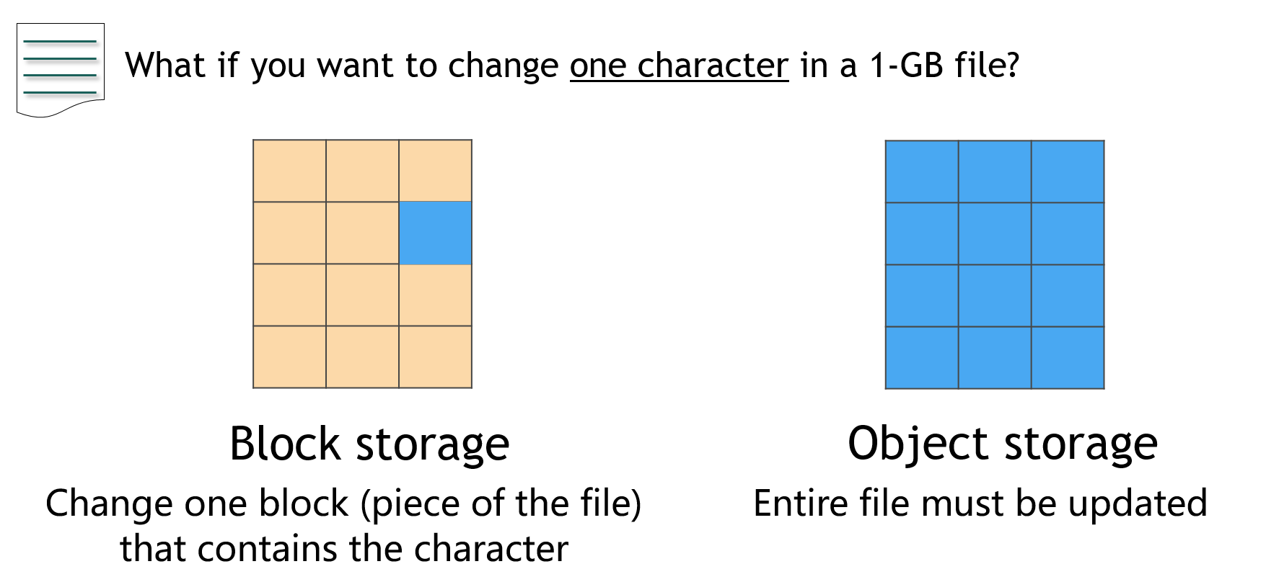
Storage Systems: Object, File, Block
Block Storage Systems
Block storage systems are used to host databases, support random read/write operations, and keep system files of the running virtual machines. Data is stored in volumes and blocks where files are split into evenly-sized blocks. Each block has its own address, but unlike objects they do not have metadata. When storing large amounts of data, files are split into smaller chunks of a fixed size, the “blocks,” which are distributed amongst the storage nodes. This also supports the volume IO performance.
Public cloud providers allow creating various file systems on their block storage systems to enable their users to store persistent data like a database.
Another advantage of using block storage in the cloud is its backup mechanism. For example, AWS EBS offers a snapshot feature that is essentially an incremental point in time backup of your volume. You can also automate this block-based backup capability for Disaster Recovery purposes.

Slide 6
Storage Systems: Object, File, Block
File level storage
Although block level storage is extremely flexible, nothing beats the simplicity of file level storage when all that's needed is a place to dump raw files. After all, simply having a centralized, highly available, and accessible place to store files and folders remains the most critical need in many organizations.
These file level devices — usually Network Attached Storage (NAS) devices — provide a lot of space at what is generally a lower cost than block level storage.
File level storage is usually accessible using common file level protocols such as SMB/CIFS (Windows) and NFS (Linux, VMware). In the block level world, you need to create a volume, deploy an OS, and then attach to the created volume; in the file level world, the storage device handles the files and folders on the device. With the caveat that you may need to take some steps with regard to authentication, permissions, and backup, file level-only devices are usually easier to set up than block level devices.
Block level devices are generally configurable for capacity and performance. Although file-level devices do have a performance component, capacity is usually the bigger consideration.

Slide 7
Storage Systems: Object, File, Block
Object Storage Systems
Enterprises use object storage for a number of different use cases, such as static content storage and distribution, backup and archiving, and disaster recovery. Object storage works very well for unstructured data sets where data is mostly read (rather than written to). It’s more of a write once, read many times use case.
Normally, each object has three major components: the data or content of the object, a unique identifier associated with the object, and metadata. The unique identifier allows developers to easily track and maintain the object details. Additionally, each object has metadata, containing contextual information about data such as its name, size, content-type, security attributes, and URL. This metadata is generally stored as a key-value pair.
For object-based storage systems, there is no hierarchy of relations between files. Two related files are not necessarily stored on the same physical medium, such as a storage node or the same disk, and the hierarchy is flat. Even though the files are not stored “together” the relationship between them can be maintained by the storage application developers.
This kind of approach provides a lot of flexibility in designing systems where files are generated and can be accessed by multiple content producers and consumers.

Slide 8
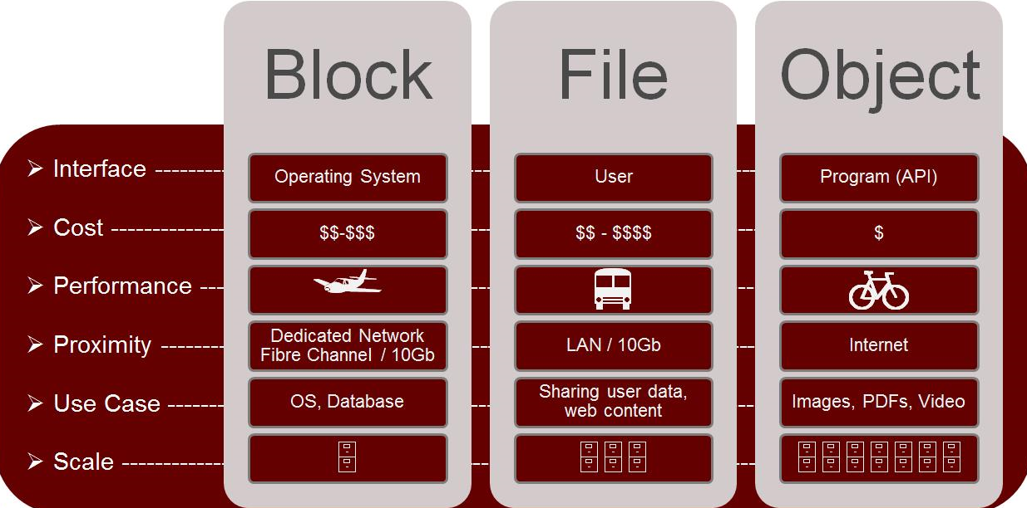
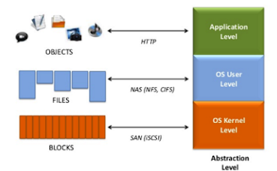
Storage Systems Compared
NTFS,FAT,APFS
NFS,NAS,CIF, SMB
?? Homework

Slide 9

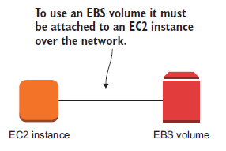
Amazon Elastic Block Store (Amazon EBS)
Amazon EBS enables you to create individual storage volumes and attach them to an Amazon EC2 instance:
Amazon EBS offers block-level storage.
Volumes are automatically replicated within its Availability Zone.
It can be backed up automatically to Amazon S3 through snapshots.
EBS volume data persists independently of the life of the instance.
You can attach multiple EBS volumes to an instance.
You cannot attach an EBS volume to multiple instances (use Elastic File Store instead).
EBS volumes must be in the same AZ as the instances they are attached to.
Uses include –
Boot volumes and storage for Amazon Elastic Compute Cloud (Amazon EC2) instances
Data storage with a file system
Database hosts
Enterprise applications
Notes:
Amazon EBS enables you to create individual storage volumes and attach them to an Amazon EC2 instance. Amazon EBS offers block-level storage, where its volumes are automatically replicated within its Availability Zone. Amazon EBS is designed to provide durable, detachable, block-level storage (which is like an external hard drive) for your Amazon EC2 instances. Because they are directly attached to the instances, they can provide low latency between where the data is stored and where it might be used on the instance.
For this reason, they can be used to run a database with an Amazon EC2 instance. Amazon EBS volumes are included as part of the backup of your instances into Amazon Machine Images (or AMIs). AMIs are stored in Amazon S3 and can be reused to create new Amazon EC2 instances later.
A backup of an Amazon EBS volume is called a snapshot. The first snapshot is called the baseline snapshot. Any other snapshot after the baseline captures only what is different from the previous snapshot.
Amazon EBS volumes uses include:
Boot volumes and storage for Amazon EC2 instances
Data storage with a file system
Database hosts
Enterprise applications

Slide 10
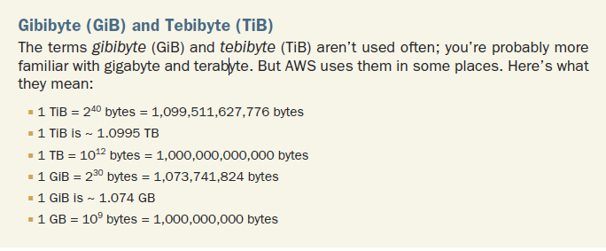
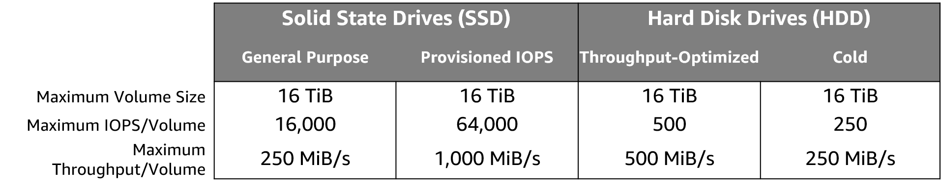
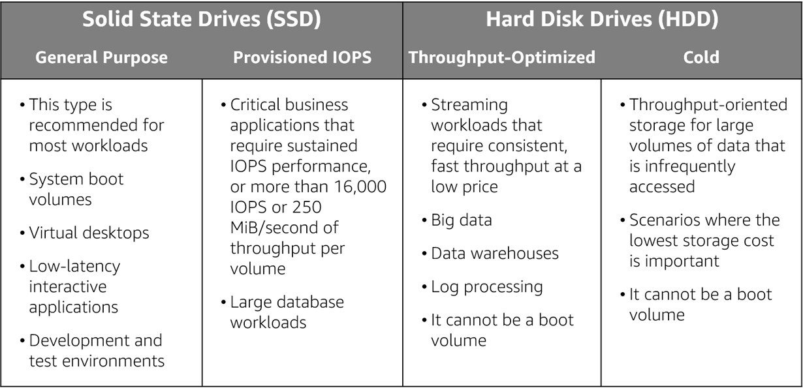
Amazon EBS volume types and use cases
Volumes, IOPS, and pricing
Volumes –
Amazon EBS volumes persist independently from the instance.
All volume types are charged by the amount that is provisioned per month.
IOPS –
General Purpose SSD: Charged by the amount that you provision in GB per month until storage is released.
Magnetic: Charged by the number of requests to the volume.
Provisioned IOPS SSD: Charged by the amount that you provision in IOPS (multiplied by the percentage of days that you provision for the month).
Notes:
Matching the correct technology to your workload is a best practice for reducing storage costs. Provisioned IOPS SSD-backed Amazon EBS volumes can give you the highest performance. However, if your application doesn't require or won't use performance that high, General Purpose SSD is usually sufficient. Only SSDs can be used as boot volumes for EC2 instances. The lower-cost options might be a solution for additional storage or use cases other than boot volumes.
To learn more, see: EBS Volume Types

Slide 11
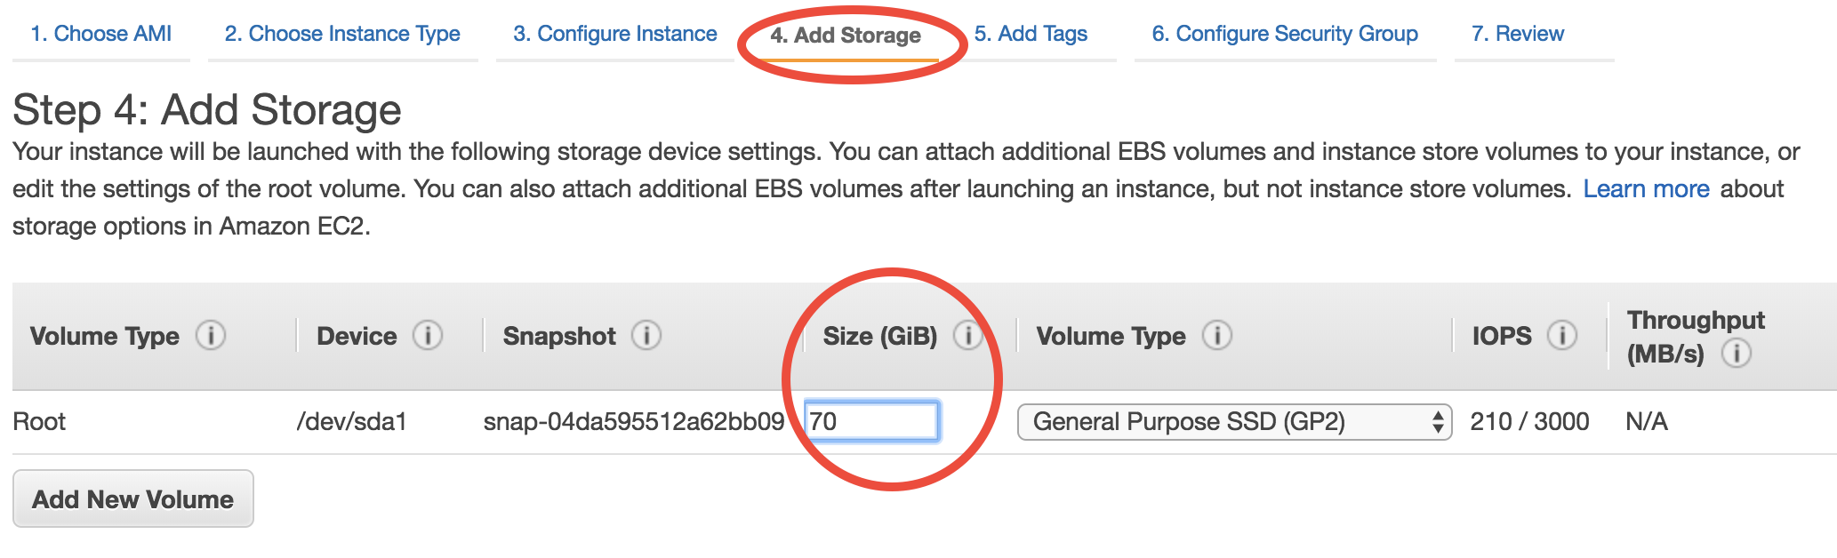
Adding EBS
Notes:
To provide an even higher level of data durability, Amazon EBS enables you to create point-in-time snapshots of your volumes, and you can re-create a new volume from a snapshot at any time. You can also share snapshots or even copy snapshots to different AWS Regions for even greater disaster recovery (DR) protection. For example, you can encrypt and share your snapshots from Virginia in the US to Tokyo, Japan.
You can also have encrypted Amazon EBS volumes at no additional cost, so the data that moves between the EC2 instance and the EBS volume inside AWS data centers is encrypted in transit.
As your company grows, the amount of data that is stored on your Amazon EBS volumes is also likely to grow. Amazon EBS volumes can increase capacity and change to different types, so you can change from hard disk drives (HDDs) to solid state drives (SSDs) or increase from a 50-GB volume to a 16-TB volume. For example, you can do this resize operation dynamically without needing to stop the instances.

Slide 12
Adding EBS
What is this? Volume type :Root
Notes:
To provide an even higher level of data durability, Amazon EBS enables you to create point-in-time snapshots of your volumes, and you can re-create a new volume from a snapshot at any time. You can also share snapshots or even copy snapshots to different AWS Regions for even greater disaster recovery (DR) protection. For example, you can encrypt and share your snapshots from Virginia in the US to Tokyo, Japan.
You can also have encrypted Amazon EBS volumes at no additional cost, so the data that moves between the EC2 instance and the EBS volume inside AWS data centers is encrypted in transit.
As your company grows, the amount of data that is stored on your Amazon EBS volumes is also likely to grow. Amazon EBS volumes can increase capacity and change to different types, so you can change from hard disk drives (HDDs) to solid state drives (SSDs) or increase from a 50-GB volume to a 16-TB volume. For example, you can do this resize operation dynamically without needing to stop the instances.

Slide 13
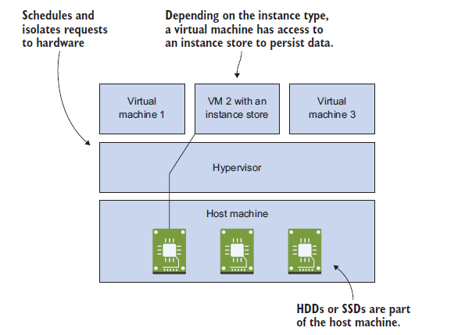
Instance Store (Ephemeral Storage)
An instance store provides block-level storage directly attached to the machine hosting your VM.
It is attached only if your instance is running; it won’t persist your data will lost if you stop or terminate the instance. ( temporary storage)
You don’t pay separately for an instance store; instance store charges are included in the EC2 instance price.
Instance store volume root devices are created from AMI templates stored on S3.
Instance store volumes cannot be detached/reattached.
Instance Storage Sources
Notes:
As mentioned previously an Amazon EBS volume is a durable, block-level storage device that you can attach to a single EC2 instance. You can use Amazon EBS volumes as primary storage for data that requires frequent updates, such as the system drive for an instance or storage for a database application. You can also use them for throughput-intensive applications that perform continuous disk scans. Amazon EBS volumes persist independently from the running life of an EC2 instance.
Use cases for EBS vary by the storage type used and whether you are using General Purpose of Provisioned IOPS.

Slide 14
Amazon EBS features
Snapshots –
Point-in-time snapshots
Recreate a new volume at any time
Added cost of Amazon EBS snapshots to Amazon S3 is per GB-month of data stored.
Encryption –
Encrypted Amazon EBS volumes
No additional cost
Elasticity –
Increase capacity
Change to different types
It is true FOR all kind STORAGE Data transfer
Inbound data transfer is free.
Outbound data transfer across Regions incurs charges.
Notes:
To provide an even higher level of data durability, Amazon EBS enables you to create point-in-time snapshots of your volumes, and you can re-create a new volume from a snapshot at any time. You can also share snapshots or even copy snapshots to different AWS Regions for even greater disaster recovery (DR) protection. For example, you can encrypt and share your snapshots from Virginia in the US to Tokyo, Japan.
You can also have encrypted Amazon EBS volumes at no additional cost, so the data that moves between the EC2 instance and the EBS volume inside AWS data centers is encrypted in transit.
As your company grows, the amount of data that is stored on your Amazon EBS volumes is also likely to grow. Amazon EBS volumes can increase capacity and change to different types, so you can change from hard disk drives (HDDs) to solid state drives (SSDs) or increase from a 50-GB volume to a 16-TB volume. For example, you can do this resize operation dynamically without needing to stop the instances.

Slide 15

Amazon Elastic File System (Amazon EFS)
EFS is a fully managed File system service that makes it easy to set up and scale file storage in the Amazon Cloud.
Works well for big data and analytics, media processing workflows, content management, web serving, and home directories etc.
Petabyte-scale, low-latency file system
Shared storage
Elastic capacity , easily it can scale up to petabytes.
Supports Network File System (NFS) versions 4.0 and 4.1 (NFSv4)
Compatible with all Linux-based AMIs for Amazon EC2
Pay for what you use (no pre-provisioning required).
EFS is elastic and grows and shrinks as you add and remove data.
Can concurrently connect 1 to 1000s of EC2 instances, from multiple AZs.
A file system can be accessed concurrently from all AZs in the region where it is located.
Read after write consistency.
Need to create mount targets and choose AZ’s to include (recommended to include all AZ’s).

Slide 16

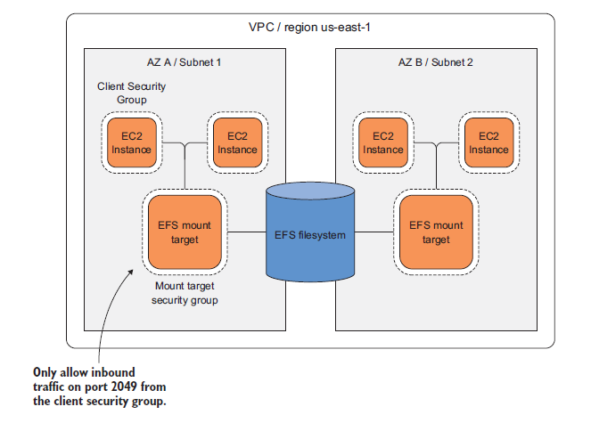
Amazon EFS architecture
Can only one per AZ
/mnt/efs
Notes:
In the diagram, the VPC has three Availability Zones, and each Availability Zone has one mount target that was created in it. We recommend that you access the file system from a mount target within the same Availability Zone. One of the Availability Zones has two subnets. However, a mount target is created in only one of the subnets.

Slide 17
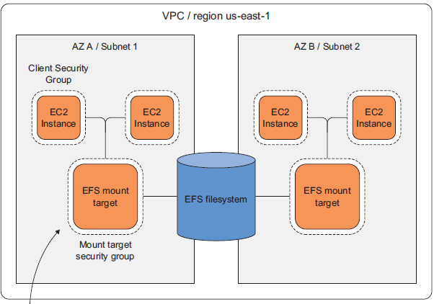
Amazon Elastic File System (Amazon EFS)
EFS provides a NFSv4.1-compliant filesystem that can be shared between Linux
EC2 instances in different availability zones.
EFS mount targets are bound to an availability zone and are protected by security groups.
You need at least two mount targets in different AZs for high availability.
EFS does not provide snapshots for point-in-time recovery.
Data that is stored in EFS is replicated across multiple AZs.

Slide 18
Amazon EFS implementation
You must below steps to create and use your first Amazon EFS file system, mount it on an Amazon EC2 instance in your VPC, and test the end-to-end setup:
Create your Amazon EC2 resources and launch your instance. (Before you can launch and connect to an Amazon EC2 instance, you must create a key pair, unless you already have one.)
Create your Amazon EFS file system.
In the appropriate subnets, create your mount targets.
Each mount target has the following properties:
The mount target ID
The subnet ID for the subnet where it was created
The file system ID for the file system where it was created
An IP address where the file system can be mounted
The mount target state
Next, connect to your Amazon EC2 instance and mount the Amazon EFS file system.
Notes:
In Amazon EFS, a file system is the primary resource. Each file system has properties such as:
ID
Creation token
Creation time
File system size in bytes
Number of mount targets that are created for the file system
File system state
Amazon EFS also supports other resources to configure the primary resource. These resources include mount targets and tags.
Mount target: To access your file system, you must create mount targets in your VPC.
Each mount target has the following properties:
The mount target ID
The subnet ID for the subnet where it was created
The file system ID for the file system where it was created
An IP address where the file system can be mounted
The mount target state
You can use the IP address or the Domain Name System (DNS) name in your mount command.
Tags: To help organize your file systems, you can assign your own metadata to each of the file systems that you create. Each tag is a key-value pair.
Think of mount targets and tags as subresources that do not exist unless they are associated with a file system.

Slide 19
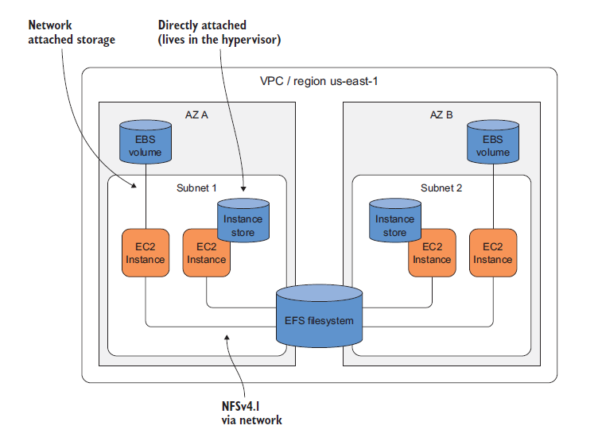
Amazon Storage Solutions

Slide 20

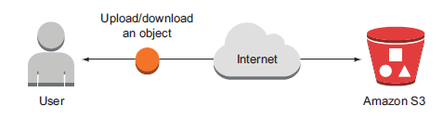
Amazon Simple Storage Solution (Amazon S3)
Amazon S3 is object storage built to store and retrieve any amount of data from anywhere – web sites and mobile apps, corporate applications and data from IoT sensors or devices.
You can store any type of file in S3.
S3 is designed to deliver 99.999999999% durability, and stores data for millions of applications used by market leaders in every industry.
S3 provides comprehensive security and compliance capabilities that meet even the most stringent regulatory requirements.
S3 gives customers flexibility in the way they manage data for cost optimization, access control, and compliance.
Files can be anywhere from 0 bytes to 5 TB.
There is unlimited storage available.
Files are stored in buckets.
Buckets are root level folders.
S3 is a universal namespace so bucket names must be unique globally.

Slide 21
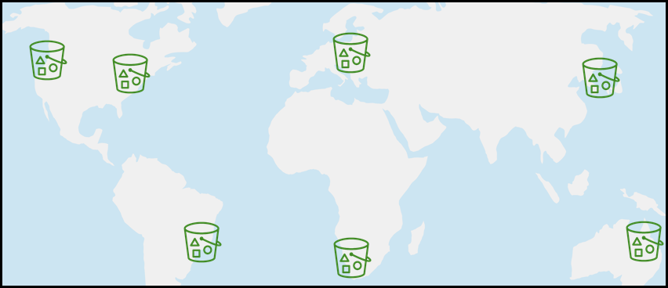
Amazon Simple Storage Solution (Amazon S3)
Typical use cases include:
• Backup and Storage – Provide data backup and storage services for others.
• Application Hosting – Provide services that deploy, install, and manage web applications.
• Media Hosting – Build a redundant, scalable, and highly available infrastructure that hosts video, photo, or music uploads and downloads.
• Software Delivery – Host your software applications that customers can download.
• Static Website – you can configure a static website to run from an S3 bucket.
Notes:
Objects can be almost any data file, such as images, videos, or server logs. Because Amazon S3 supports objects as large as several terabytes in size, you can even store database snapshots as objects. Amazon S3 also provides low-latency access to the data over the internet by Hypertext Transfer Protocol (HTTP) or Secure HTTP (HTTPS), so you can retrieve data anytime from anywhere. You can also access Amazon S3 privately through a virtual private cloud (VPC) endpoint. You get fine-grained control over who can access your data by using AWS Identity and Access Management (IAM) policies, Amazon S3 bucket policies, and even per-object access control lists.
By default, none of your data is shared publicly. You can also encrypt your data in transit and choose to enable server-side encryption on your objects.
You can access Amazon S3 through the web-based AWS Management Console; programmatically through the API and SDKs; or with third-party solutions, which use the API or the SDKs.

Slide 22
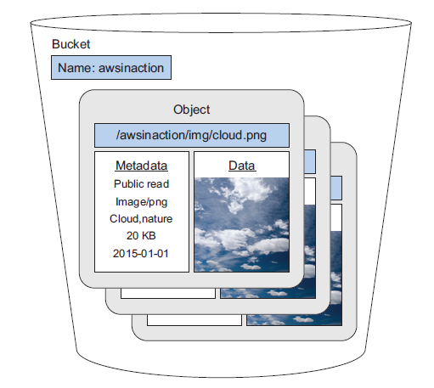
Amazon S3 Bucket
Bucket names must follow a set of rules:
Names must be unique across all of AWS.
Names must be 3 to 63 characters in length.
Names can only contain lowercase letters, numbers and hyphens.
Names cannot be formatted as an IP address.
When you create a bucket, you need to select the region where it will be created.
It is a best practice to create buckets in regions that are physically closest to your users to reduce latency.
Data consistency:
Read after write consistency for PUTS of new objects.
Eventual consistency for overwrite PUTS and DELETES (takes time to propagate).
Objects consist of:
Key (name of the object).
Value (data made up of a sequence of bytes).
Version ID (used for versioning).
Metadata (data about the data that is stored).

Slide 23

Amazon S3 bucket URLs (two styles)
Amazon S3
To upload your data:
Create a bucket in an AWS Region.
Upload almost any number of objects to the bucket.
Bucket path-style URL endpoint:
https://s3.ap-northeast-1.amazonaws.com/bucket-name
[bucket name]
Region code
Bucket name
Bucket virtual hosted-style URL endpoint:
Preview2.mp4
https:// bucket-name.s3-ap-northeast-1.amazonaws.com
Tokyo Region (ap-northeast-1)
Bucket name
Region code
Notes:
To use Amazon S3 effectively, you must understand a few simple concepts. First, Amazon S3 stores data inside buckets. Buckets are essentially the prefix for a set of files, and must be uniquely named across all of Amazon S3 globally. Buckets are logical containers for objects. You can have one or more buckets in your account. You can control access for each bucket—who can create, delete, and list objects in the bucket. You can also view access logs for the bucket and its objects, and choose the geographical region where Amazon S3 stores the bucket and its contents.
To upload your data (such as photos, videos, or documents), create a bucket in an AWS Region, and then upload almost any number of objects to the bucket.
In the example, Amazon S3 was used to create a bucket in the Tokyo Region, which is identified within AWS formally by its Region code: ap-northeast-1
The URL for a bucket is structured like the examples. You can use two different URL styles to refer to buckets.
Amazon S3 refers to files as objects. As soon as you have a bucket, you can store almost any number of objects inside it. An object is composed of data and any metadata that describes that file, including a URL. To store an object in Amazon S3, you upload the file that you want to store to a bucket.
When you upload a file, you can set permissions on the data and any metadata.
In this example, the object Preview2.mp4 is stored inside the bucket. The URL for the file includes the object name at the end.

Slide 24
Amazon S3 storage classes
Amazon S3 offers a range of object-level storage classes that are designed for different use cases:
Amazon S3 Standard
Amazon S3 Intelligent-Tiering
Amazon S3 Standard-Infrequent Access (Amazon S3 Standard-IA)
Amazon S3 One Zone-Infrequent Access (Amazon S3 One Zone-IA)
Amazon S3 Glacier
Amazon S3 Glacier Deep Archive
Notes:
Amazon S3 offers a range of object-level storage classes that are designed for different use cases. These classes include:
Amazon S3 Standard – Amazon S3 Standard is designed for high durability, availability, and performance object storage for frequently accessed data. Because it delivers low latency and high throughput, Amazon S3 Standard is appropriate for a variety of use cases, including cloud applications, dynamic websites, content distribution, mobile and gaming applications, and big data analytics.
Amazon S3 Intelligent-Tiering – The Amazon S3 Intelligent-Tiering storage class is designed to optimize costs by automatically moving data to the most cost-effective access tier, without performance impact or operational overhead. For a small monthly monitoring and automation fee per object, Amazon S3 monitors access patterns of the objects in Amazon S3 Intelligent-Tiering, and moves the objects that have not been accessed for 30 consecutive days to the infrequent access tier. If an object in the infrequent access tier is accessed, it is automatically moved back to the frequent access tier. There are no retrieval fees when you use the Amazon S3 Intelligent-Tiering storage class, and no additional fees when objects are moved between access tiers. It works well for long-lived data with access patterns that are unknown or unpredictable.
Amazon S3 Standard-Infrequent Access (Amazon S3 Standard-IA) – The Amazon S3 Standard-IA storage class is used for data that is accessed less frequently, but requires rapid access when needed. Amazon S3 Standard-IA is designed to provide the high durability, high throughput, and low latency of Amazon S3 Standard, with a low per-GB storage price and per-GB retrieval fee. This combination of low cost and high performance makes Amazon S3 Standard-IA good for long-term storage and backups, and as a data store for disaster recovery files.
Amazon S3 One Zone-Infrequent Access (Amazon S3 One Zone-IA) – Amazon S3 One Zone-IA is for data that is accessed less frequently, but requires rapid access when needed. Unlike other Amazon S3 storage classes, which store data in a minimum of three Availability Zones, Amazon S3 One Zone-IA stores data in a single Availability Zone and it costs less than Amazon S3 Standard-IA. Amazon S3 One Zone-IA works well for customers who want a lower-cost option for infrequently accessed data, but do not require the availability and resilience of Amazon S3 Standard or Amazon S3 Standard-IA. It is a good choice for storing secondary backup copies of on-premises data or easily re-creatable data. You can also use it as cost-effective storage for data that is replicated from another AWS Region by using Amazon S3 Cross-Region Replication.
Amazon S3 Glacier – Amazon S3 Glacier is a secure, durable, and low-cost storage class for data archiving. You can reliably store any amount of data at costs that are competitive with—or cheaper than—on-premises solutions. To keep costs low yet suitable for varying needs, Amazon S3 Glacier provides three retrieval options that range from a few minutes to hours. You can upload objects directly to Amazon S3 Glacier, or use Amazon S3 lifecycle policies to transfer data between any of the Amazon S3 storage classes for active data (Amazon S3 Standard, Amazon S3 Intelligent-Tiering, Amazon S3 Standard-IA, and Amazon S3 One Zone-IA) and Amazon S3 Glacier.
Amazon S3 Glacier Deep Archive – Amazon S3 Glacier Deep Archive is the lowest-cost storage class for Amazon S3. It supports long-term retention and digital preservation for data that might be accessed once or twice in a year. It is designed for customers — particularly customers in highly regulated industries, such as financial services, healthcare, and public sectors — that retain datasets for 7–10 years (or more) to meet regulatory compliance requirements. Amazon S3 Glacier Deep Archive can also be used for backup and disaster recovery use cases. It is a cost-effective and easy-to-manage alternative to magnetic tape systems, whether these tape systems are on-premises libraries or off-premises services. Amazon S3 Glacier Deep Archive complements Amazon S3 Glacier, and it is also designed to provide 11 9s of durability. All objects that are stored in Amazon S3 Glacier Deep Archive are replicated and stored across at least three geographically dispersed Availability Zones, and these objects can be restored within 12 hours.
For more information see, Amazon S3 storage classes.

Slide 25
Amazon S3 pricing
You do not pay for,
Transfers IN to Amazon S3
Transfers OUT from Amazon S3 to Amazon CloudFront or Amazon EC2 in the same Region
To estimate Amazon S3 costs, consider the following:
You pay for ,
Storage class type ,
Standard storage is designed for:
S3 Standard-Infrequent Access (S-IA) is designed for:
Amount of storage : The number and size of objects GiB
Requests,
The number and type of requests (GET, PUT, COPY)
Type of requests:
Different rates for GET requests than other requests.
Data transfer,
Pricing is based on the amount of data that is transferred out of the Amazon S3 Region
Data transfer in is free, but you incur charges for data that is transferred out.
Notes:
With Amazon S3, specific costs vary depending on the Region and the specific requests that were made. You pay only for what you use, including gigabytes per month; transfer out of other Regions; and PUT, COPY, POST, LIST, and GET requests. As a general rule, you pay only for transfers that cross the boundary of your Region, which means you do not pay for transfers in to Amazon S3 or transfers out from Amazon S3 to Amazon CloudFront edge locations within that same Region.

Slide 26
Amazon S3 Glacier
Amazon S3 Glacier is a data archiving service.
When you use Amazon S3 Glacier to archive data, you can store your data at low cost (even in comparison to Amazon S3), but you cannot retrieve your data immediately when you want it.
Data that is stored in Amazon S3 Glacier can take several hours to retrieve, which is why it works well for archiving.
There are three key Amazon S3 Glacier terms you should be familiar with:
Archive – Any object (such as a photo, video, file, or document) that you store in Amazon S3 Glacier. It is the base unit of storage in Amazon S3 Glacier. Each archive has its own unique ID and it can also have a description.
Vault – A container for storing archives. When you create a vault, you specify the vault name and the Region where you want to locate the vault.
Vault access policy – Determine who can and cannot access the data that is stored in the vault, and what operations users can and cannot perform.
One vault access permissions policy can be created for each vault to manage access permissions for that vault.
You can also use a vault lock policy to make sure that a vault cannot be altered.
Each vault can have one vault access policy and one vault lock policy that are attached to it.

Slide 27
Amazon S3 Glacier
You have three options for retrieving data, each with varying access times and cost:
Expedited retrievals are typically made available within 1–5 minutes (highest cost).
Standard retrievals typically complete within 3–5 hours (less time than expedited, more time than bulk).
Bulk retrievals typically complete within 5–12 hours (lowest cost).
You might compare these options to choosing the cost for shipping a package by using the most economical method for your needs.

Slide 28
Amazon S3 Glacier
You have three options for retrieving data, each with varying access times and cost:
Expedited retrievals are typically made available within 1–5 minutes (highest cost).
Standard retrievals typically complete within 3–5 hours (less time than expedited, more time than bulk).
Bulk retrievals typically complete within 5–12 hours (lowest cost).
You might compare these options to choosing the cost for shipping a package by using the most economical method for your needs.

Slide 29
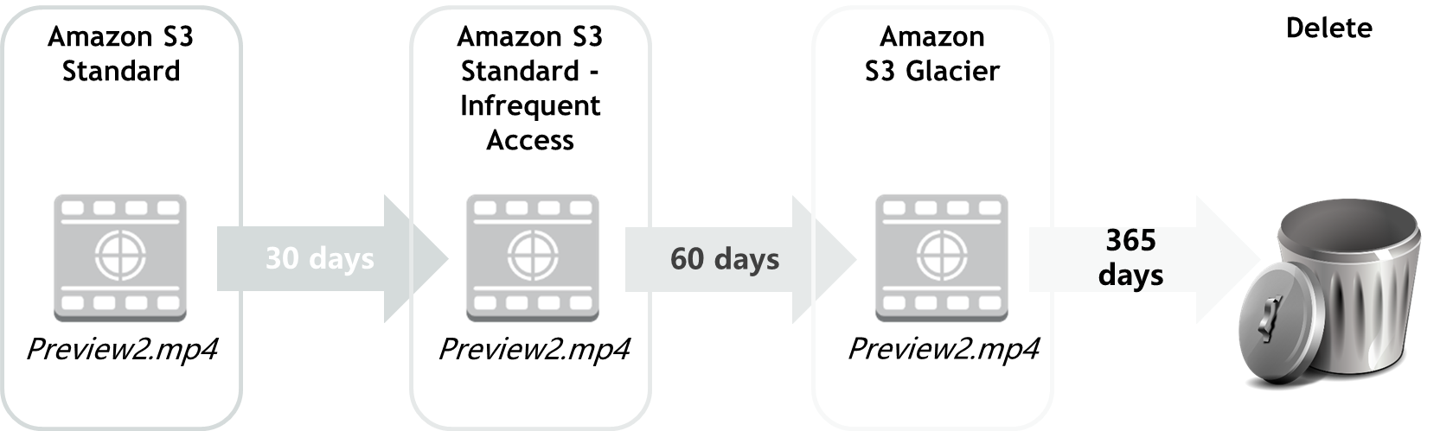
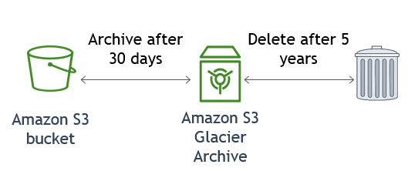
Amazon S3 Lifecyce Policy Examples

Slide 30
Storage comparison
 | Amazon S3 | Amazon S3 Glacier
Data Volume | No limit | No limit
Average Latency | ms | minutes/hours
Item Size | 5 TB maximum | 40 TB maximum
Cost/GB per Month | Higher cost | Lower cost
Billed Requests | PUT, COPY, POST, LIST, and GET | UPLOAD and retrieval
Retrieval Pricing | ¢ Per request | ¢¢ Per request and per GB
Notes:
While Amazon S3 and Amazon S3 Glacier are both object storage solutions that enable you to store a virtually unlimited amount of data, they have some critical differences between them. The chart outlines some of these differences.
Be careful when you decide which storage solution is correct for your needs. These two services serve very different storage needs. Amazon S3 is designed for frequent, low-latency access to your data, but Amazon S3 Glacier is designed for low-cost, long-term storage of infrequently accessed data.
The maximum item size in Amazon S3 is 5 TB, but Amazon S3 Glacier can store items that are up to 40 TB.
Because Amazon S3 gives you faster access to your data, the storage cost per gigabyte is higher than it is with Amazon S3 Glacier.
While both services have per-request charges, Amazon S3 charges for PUT, COPY, POST, LIST, GET operations. In contrast, Amazon S3 Glacier charges for UPLOAD and retrieval operations.
Because Amazon S3 Glacier was designed for less-frequent access to data, it costs more for each retrieval request than Amazon S3.

Slide 31
AWS Snowball
AWS Snowball
Petabyte-scale data transport
Can transport multiple terabytes of data into or out of Amazon S3
Multiple devices can be used to transfer petabytes
Addresses concerns of large data transfers (network costs, transfer times, security)
Example: To transfer 10 petabytes (10 million GB) over the internet with a 10 Gbps upload speed would take over 100 days
To use
Create a job in the AWS Management Console and a Snowball will be shipped to you.
Attach to your local network, then download and run the Snowball Client
Select the file directories to transfer (encrypted) to the device
Ship the device back and track the status
AWS Snowball
Notes:
AWS Snowball is a petabyte-scale data transport option that doesn’t require you to write any code or purchase any hardware to transfer your data. All you need to do is create a job in the AWS Management Console, and a Snowball appliance will be shipped to you. Attach the appliance to your local network and transfer files directly onto it. Then, ship it back and track the status of your shipment. When it arrives at the secure Amazon facility, the data will be transferred into your AWS account.

Slide 32
AWS Snowmobile
AWS Snowmobile
Exabyte-scale data transport
A 45-foot-long (13.7 meters) shipping container, pulled by a semi-trailer truck
Can transfer up to 100 PB per Snowmobile
Offers multiple layers of security –
Dedicated security personnel
GPS tracking, alarm monitoring, 24/7 video surveillance
Optional escort security vehicle while in transit
Data encrypted with 256-bit encryption keys
AWS Snowmobile
Notes:
AWS Snowmobile is an even larger data transfer option that operates in exabyte scale. An exabyte is 1 million terabytes or 1 billion gigabytes. It should only be used to move extremely large amounts of data into AWS. A Snowmobile is a 45-foot-lonf (13.7 meters) ruggedized shipping container that is pulled by a semi-trailer truck. You can transfer 100 PB per Snowmobile.
If you tried to transfer 100 petabytes of data over the internet, with an upload speed of 10 Gbps (assuming a TCP/IP overhead of 10%), it would take approximately 1018 days (almost three years) to finish uploading the data. That would not be practical. In such cases, using AWS Snowmobile to transfer the data would be a better option.
Snowmobile uses multiple layers of security designed to protect your data, including dedicated security personnel, GPS tracking, alarm monitoring, 24/7 video surveillance, and an optional escort security vehicle while in transit. All data is encrypted with 256-bit encryption keys managed through AWS Key Management Service (AWS KMS) and designed to ensure both security and full chain-of-custody of your data.

Slide 33
Questions?
Q1: Which Amazon Machine Image can be used to mount an Amazon Elastic File System (EFS) file system?
A. Microsoft Windows Server 2019 with Containers
B. Microsoft Windows Server 2016 Core
C. Amazon Linux 2 AMI
D. All of the above

Slide 34
Questions?
Q1: Which Amazon Machine Image can be used to mount an Amazon Elastic File System (EFS) file system?
A. Microsoft Windows Server 2019 with Containers
B. Microsoft Windows Server 2016 Core
C. Amazon Linux 2 AMI
D. All of the above
Q2: Which storage device is physically attached to the Amazon EC2 host servers?
A. Amazon Elastic Block Store (EBS) volume
B. Amazon Machine Image (AMI)
C. Instance Store volume
D. Elastic Network Adapter

Slide 35
Questions?
Q1: Which Amazon Machine Image can be used to mount an Amazon Elastic File System (EFS) file system?
A. Microsoft Windows Server 2019 with Containers
B. Microsoft Windows Server 2016 Core
C. Amazon Linux 2 AMI
D. All of the above
Q2: Which storage device is physically attached to the Amazon EC2 host servers?
A. Amazon Elastic Block Store (EBS) volume
B. Amazon Machine Image (AMI)
C. Instance Store volume
D. Elastic Network Adapter
Q3: Which Amazon S3 storage class is used for archiving data for long term retention?
A. S3 Standard
B. S3 Intelligent-Tiering
C. S3 One Zone-IA
D. S3 Glacier Deep Archive

Slide 36
Questions?
Q1: Which Amazon Machine Image can be used to mount an Amazon Elastic File System (EFS) file system?
A. Microsoft Windows Server 2019 with Containers
B. Microsoft Windows Server 2016 Core
C. Amazon Linux 2 AMI
D. All of the above
Q2: Which storage device is physically attached to the Amazon EC2 host servers?
A. Amazon Elastic Block Store (EBS) volume
B. Amazon Machine Image (AMI)
C. Instance Store volume
D. Elastic Network Adapter
Q3: Which Amazon S3 storage class is used for archiving data for long term retention?
A. S3 Standard
B. S3 Intelligent-Tiering
C. S3 One Zone-IA
D. S3 Glacier Deep Archive
Q4: With default settings, what will happen to a root EBS volume when the Amazon EC2 instance is terminated?
A. It will be deleted
B. It will be retained
C. A snapshot will be retained
D. An AMI will be created

Slide 37
Questions?
Q1: Which Amazon Machine Image can be used to mount an Amazon Elastic File System (EFS) file system?
A. Microsoft Windows Server 2019 with Containers
B. Microsoft Windows Server 2016 Core
C. Amazon Linux 2 AMI
D. All of the above
Q2: Which storage device is physically attached to the Amazon EC2 host servers?
A. Amazon Elastic Block Store (EBS) volume
B. Amazon Machine Image (AMI)
C. Instance Store volume
D. Elastic Network Adapter
Q3: Which Amazon S3 storage class is used for archiving data for long term retention?
A. S3 Standard
B. S3 Intelligent-Tiering
C. S3 One Zone-IA
D. S3 Glacier Deep Archive
Q4: With default settings, what will happen to a root EBS volume when the Amazon EC2 instance is terminated?
A. It will be deleted
B. It will be retained
C. A snapshot will be retained
D. An AMI will be created

